Slide 1
Research Methodology

Slide 2
Research Methodology:
An Introduction:
MEANING OF RESEARCH:
Research refers to a search for knowledge.
Once can also define research as a scientific & systematic search for pertinent information on a specific topic.
In fact, research is an art of scientific investigation.
Research is an academic activity and as such the term should be used in a technical sense.
According to Clifford Woody research comprises defining and redefining problems, formulating hypothesis or suggested solutions; collecting, organizing and evaluating data; making deductions and reaching conclusions; and at last carefully testing the conclusions to determine whether they fit the formulating hypothesis.

Slide 3
OBJECTIVES OF RESEARCH
1. To gain familiarity with a phenomenon or to achieve new insights into it (studies with this object in view are termed as exploratory or formulative research studies);
2. To portray accurately the characteristics of a particular individual, situation or a group(studies with this object in view are known as descriptive research studies);
3. To determine the frequency with which something occurs or with which it is associated with something else (studies with this object in view are known as diagnostic research studies);
4. To test a hypothesis of a causal relationship between variables (such studies are known as hypothesis-testing research studies).

Slide 4
MOTIVATION OF RESEARCH
1. Desire to get a research degree along with its consequential benefits;
2. Desire to face the challenge in solving the unsolved problems, i.e., concern over practical
problems initiates research;
3. Desire to get intellectual joy of doing some creative work;
4. Desire to be of service to society;
5. Desire to get respectability.
However, this is not an exhaustive list of factors motivating people to undertake research studies.
Many more factors such as directives of government, employment conditions, curiosity about new things, desire to understand causal relationships, social thinking and awakening, and the like may as well motivate (or at times compel) people to perform research operations.

Slide 5
TYPES OF RESEARCH
(i) Descriptive vs. Analytical:
Descriptive research includes surveys and fact-finding enquiries of different kinds.
In social science and business research we quite often use the term Ex post facto research for descriptive research studies.
The main characteristic of this method is that the researcher has no control over the variables; he can only report what has happened or what is happening.
The methods of research utilized in descriptive research are survey methods of all kinds, including comparative and correlation methods.
In analytical research, on the other hand, the researcher has to use facts or information already available, and analyze these to make a critical evaluation of the material.

Slide 6
(ii) Applied vs. Fundamental:
Applied (or action) research : aims at finding a solution for an immediate problem facing a society or an industrial/business organization.
Fundamental (to basic or pure) research: is mainly concerned with generalizations and with the formulation of a theory. Finds solution for math's or human behavior.

Slide 7
(iii) Quantitative vs. Qualitative:
Quantitative research is based on the measurement of quantity or amount.
Research designed to find out how people feel or what they think about a particular subject or institution is also qualitative research.
Ex-How many people given vote.
Qualitative research, on the other hand, is concerned with qualitative phenomenon, i.e., phenomena relating to or involving quality or kind.
Ex- Why few peoples have only given the vote.

Slide 8
(iv) Conceptual vs. Empirical:
Conceptual research :
is that related to some abstract idea(s) or theory.
It is generally used by philosophers and thinkers to develop new concepts or to reinterpret existing ones.
Empirical research ;
It is data-based research, coming up with conclusions which are capable of being verified by observation or experiment. We can also call it as experimental type of research.

Slide 9
(v) Some Other Types of Research:
One-time research or longitudinal research. In the former case the research is confined to a single time-period, whereas in the latter case the research is carried on over several time-periods.
Field-setting research or laboratory research or simulation research, depending upon the environment in which it is to be carried out.
Clinical or diagnostic research. Such research follow case-study methods or in-depth approaches to reach the basic causal relations.
Conclusion-oriented and decision-oriented. While doing conclusion-oriented research, a researcher is free to pick up a problem, redesign the enquiry as he proceeds and is prepared to conceptualize as he wishes.

Slide 10
The exploratory research or it may be formalized.
The objective of exploratory research is the development of hypotheses rather than their testing, whereas formalized research studies are those with substantial structure and with specific hypotheses to be tested.
Historical research is that which utilizes historical sources like documents, remains, etc. to study events or ideas of the past, including the philosophy of persons and groups at any remote point of time.

Slide 11
Significance of Research
“All progress is born of inquiry. Doubt is often better than overconfidence, for it leads to inquiry, and inquiry leads to invention” is a famous Hudson Maxim in context of which the significance of research can well be understood.
Increased amounts of research make progress possible.
Research inculcates scientific and inductive thinking and it promotes the development of logical habits of thinking and organisation.
The role of research in several fields of applied economics, whether related to business or to the economy as a whole, has greatly increased in modern times.
The increasingly complex nature of business and government has focused attention on the use of research in solving operational problems. Research, as an aid to economic policy, has gained added importance, both for government and business.
Research provides the basis for nearly all government policies in our economic system.
For instance, government’s budgets rest in part on an analysis of the needs and desires of the people and on the availability of revenues to meet these needs. The cost of needs has to be equated to probable revenues and this is a field where research is most needed. Through research we can devise alternative policies and can as well examine the consequences of each of these alternatives.

Slide 12
Research Methods versus Methodology
Research methods or techniques, thus, refer to the methods the researchers use in performing research operations.
Thus, when we talk of research methodology we not only talk of the research methods but also consider the logic behind the methods we use in the context of our research study and explain why we are using a particular method or technique and why we are not using others so that research results are capable of being evaluated either by the researcher himself or by others.

Slide 13
Research Methods versus Methodology
It seems appropriate at this juncture to explain the difference between research methods and research methodology.
Research methods may be understood as all those methods/techniques that are used for conduction of research.
A distinction is also made between research techniques and research methods.
Research techniques refer to the behavior and instruments we use in performing research operations such as making observations, recording data, techniques of processing data and the like.
Research methods refer to the behavior and instruments used in selecting and constructing research technique.
For instance, the difference between methods and techniques of data collection can better be understood from the details given in the following chart.

Slide 14
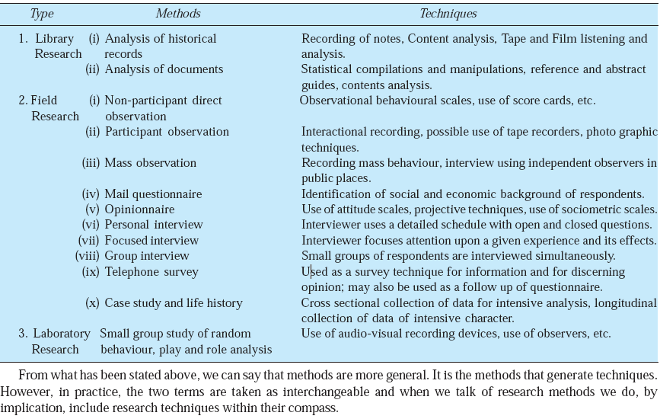

Slide 15
All those methods which are used by the researcher during the course of studying his research problem are termed as research methods.
Research methods can be put into the following three groups:
1. In the first group we include those methods which are concerned with the collection of data. These methods will be used where the data already available are not sufficient to arrive at the required solution;
2. The second group consists of those statistical techniques which are used for establishing relationships between the data and the unknowns;
3. The third group consists of those methods which are used to evaluate the accuracy of the results obtained.
Research methods falling in the above stated last two groups are generally taken as the analytical tools of research.

Slide 16
Research and Scientific Method
For a clear perception of the term research, one should know the meaning of scientific method.
The two terms, research and scientific method, are closely related.
Research, as we have already stated, can be termed as “an inquiry into the nature of, the reasons for, and the consequences of any particular set of circumstances, whether these circumstances are experimentally controlled or recorded just as they occur.
Further, research implies the researcher is interested in more than particular results; he is interested in the repeatability of the results and in their extension to more complicated and general situations.”
On the other hand, the philosophy common to all research methods and techniques, although they may vary considerably from one science to another, is usually given the name of scientific method.

Slide 17
Research and Scientific Method…
In this context, Karl Pearson writes, “The scientific method is one and same in the branches (of science) and that method is the method of all logically trained minds …
the unity of all sciences consists alone in its methods, not its material; the man who classifies facts of any kind whatever, who sees their mutual relation and describes their sequences, is applying the Scientific Method and is a man of science.”
Scientific method is the pursuit of truth as determined by logical considerations. The ideal of science is to achieve a systematic interrelation of facts. Scientific method attempts to achieve “.
this ideal by experimentation, observation, logical arguments from accepted postulates and a combination of these three in varying proportions.”
In scientific method, logic aids in formulating propositions explicitly and accurately so that their possible alternatives become clear.
for their conclusions

Slide 18
Research and Scientific Method…
Further, logic develops the consequences of such alternatives, and when these are compared with observable phenomena, it becomes possible for the researcher or the scientist to state which alternative is most in harmony with the observed facts. All this is done through experimentation and survey investigations which constitute the integral parts of scientific method.
Experimentation is done to test hypotheses and to discover new relationships. If any, among variables. But the conclusions drawn on the basis of experimental data are generally criticized for either faulty assumptions, poorly designed experiments, badly executed experiments or faulty interpretations. As such the researcher must pay all possible attention while developing the experimental design and must state only probable inferences. The purpose of survey investigations may also be to provide scientifically gathered information to work as a basis for the researchers for their conclusions

Slide 19
The scientific method is, thus, based on certain basic postulates which can be stated as under:
1. It relies on empirical evidence;
2. It utilizes relevant concepts;
3. It is committed to only objective considerations;
4. It presupposes ethical neutrality, i.e., it aims at nothing but making only adequate and correct statements about population objects;
5. It results into probabilistic predictions.
6. Its methodology is made known to all concerned for critical scrutiny are for use in testing the conclusions through replication;
7. It aims at formulating most general axioms or what can be termed as scientific theories.

Slide 20
Importance of Knowing How Research is Done
(i) For one who is preparing himself for a career of carrying out research, the importance of
knowing research methodology and research techniques is obvious since the same constitute
the tools of his trade. The knowledge of methodology provides good training specially to the
new research worker and enables him to do better research. It helps him to develop disciplined
thinking or a ‘bent of mind’ to observe the field objectively. Hence, those aspiring for
careerism in research must develop the skill of using research techniques and must thoroughly
understand the logic behind them.
(ii) Knowledge of how to do research will inculcate the ability to evaluate and use research
results with reasonable confidence.
In other words, we can state that the knowledge of research methodology is helpful in various fields such as government or business administration, community development and social work where persons are increasingly called upon to evaluate and use research results for action.

Slide 21
(iii) When one knows how research is done, then one may have the satisfaction of acquiring a new intellectual tool which can become a way of looking at the world and of judging every day experience. Accordingly, it enables use to make intelligent decisions concerning problems facing us in practical life at different points of time. Thus, the knowledge of research methodology provides tools to took at things in life objectively.
(iv) In this scientific age, all of us are in many ways consumers of research results and we can use them intelligently provided we are able to judge the adequacy of the methods by which they have been obtained. The knowledge of methodology helps the consumer of research results to evaluate them and enables him to take rational decisions.

Slide 22
research process guideline:
Formulating the research problem;
(2) extensive literature survey;
(3) developing the hypothesis;
(4) preparing the research design;
(5) determining sample design;
(6) collecting the data;
(7) execution of the project;
(8) analysis of data;
(9) hypothesis testing;
(10) generalisations and interpretation,
(11) preparation of the report or presentation of the results ,i. e., formal write-up of conclusions reached.

Slide 23
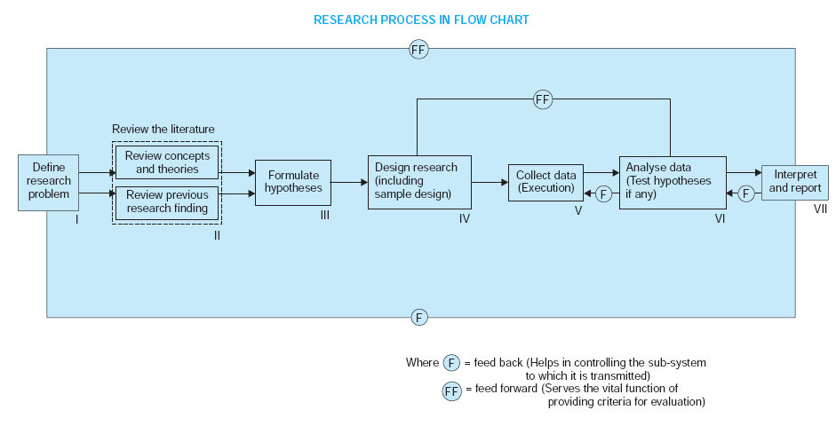

Slide 24
1. Formulating the research problem:
There are two types of research problems, viz., those which relate to states of nature and those which relate to relationships between variables.
Initially the problem may be stated in a broad general way and then the ambiguities, if any, relating to the problem be resolved. Then, the feasibility of a particular solution has to be considered before a working formulation of the problem can be set up.
The formulation of a general topic into a specific research problem, thus, constitutes the first step in a scientific enquiry.
Essentially two steps are involved in formulating the research problem, viz., understanding the problem thoroughly, and rephrasing the same into meaningful terms from an analytical point of view.

Slide 25
2. Extensive literature survey:
Once the problem is formulated, a brief summary of it should be written down.
It is compulsory for a research worker writing a thesis for a Ph.D. degree to write a synopsis of the topic and submit it to the necessary Committee or the Research Board for approval.
At this juncture the researcher should undertake extensive literature survey connected with the problem.

Slide 26
3. Development of working hypotheses:
After extensive literature survey, researcher should state in clear terms the working hypothesis or hypotheses.
Working hypothesis is tentative assumption made in order to draw out and test its logical or empirical consequences.
How does one go about developing working hypotheses? The answer is by using the following approach:
(a) Discussions with colleagues and experts about the problem, its origin and the objectives in seeking a solution;
(b) Examination of data and records, if available, concerning the problem for possible trends, peculiarities and other clues;
(c) Review of similar studies in the area or of the studies on similar problems; and
(d) Exploratory personal investigation which involves original field interviews on a limited scale with interested parties and individuals with a view to secure greater insight into the practical aspects of the problem.

Slide 27
4. Preparing the research design:
The research problem having been formulated in clear terms, the researcher will be required to prepare a research design, i.e., he will have to state the conceptual structure within which research would be conducted.
Research purposes may be grouped into four categories:
(i) Exploration
(ii) Description
(iii) Diagnosis
(iv) Experimentation.

Slide 28
The preparation of the research design, appropriate for a particular research problem, involves usually the consideration of the following:
(i) the means of obtaining the information;
(ii) the availability and skills of the researcher and his staff (if any);
(iii) explanation of the way in which selected means of obtaining information will be organized and the reasoning leading to the selection;
(iv) the time available for research; and
(v) the cost factor relating to research, i.e., the finance available for the purpose.

Slide 29
5. Determining sample design:
Sample design is a definite plan determined before any data are actually collected for obtaining a sample from a given population.
A brief mention of the important sample designs is as follows:
(i) Deliberate sampling: Deliberate sampling is also known as purposive or non-probability sampling.
Convivence Sampling- Collect data from population elements.
Judgement Sampling- Researcher’s judgement is used for selecting items which he considers as representative of the population.

Slide 30
(ii) Simple random sampling:
This type of sampling is also known as chance sampling or probability sampling where each and every item in the population has an equal chance of inclusion in the sample and each one of the possible samples, in case of finite universe, has the same probability of being selected.

Slide 31
(iii) Systematic sampling: In some instances the most practical way of sampling is to select every 15th name on a list, every 10th house on one side of a street and so on. This procedure is useful when sampling frame is available in the form of a list. In such a design the selection process starts by picking some random point in the list and then every nth element is selected until the desired number is secured.
(iv) Stratified sampling: If the population from which a sample is to be drawn does not constitute a homogeneous group, then stratified sampling technique is applied so as to obtain a representative sample. In this technique, the population is stratified into a number of nonoverlapping subpopulations or strata and sample items are selected from each stratum. If the items selected from each stratum is based on simple random sampling the entire procedure, first stratification and then simple random sampling, is known as stratified random sampling.

Slide 32
(v) Quota sampling:
In stratified sampling the cost of taking random samples from individual strata is often so expensive that interviewers are simply given quota to be filled from different strata, the actual selection of items for sample being left to the interviewer’s judgement.
(vi) Cluster sampling and area sampling:
Cluster sampling involves grouping the population and then selecting the groups or the clusters rather than individual elements for inclusion in the sample.
The clustering approach can, however, make the sampling procedure relatively easier and increase the efficiency of field work, specially in the case of personal interviews.
Area sampling is quite close to cluster sampling and is often talked about when the total geographical area of interest happens to be big one. Under area sampling we first divide the total area into a number of smaller non-overlapping areas, generally called geographical clusters, then a number of these smaller areas are randomly selected, and all units in these small areas are included in the sample.
Area sampling is specially helpful where we do not have the list of the population concerned. It also makes the field interviewing more efficient since interviewer can do many interviews at each location.

Slide 33
(vii) Multi-stage sampling:
This is a further development of the idea of cluster sampling. This technique is meant for big inquiries extending to a considerably large geographical area like an entire country. Under multi-stage sampling the first stage may be to select large primary sampling units such as states, then districts, then towns and finally certain families within towns.
(viii) Sequential sampling:
This is somewhat a complex sample design where the ultimate size of the sample is not fixed in advance but is determined according to mathematical decisions on the basis of information yielded as survey progresses.

Slide 34
6. Collecting the data:
Data can be collected by any one or more of the following ways:
(i) By observation
(ii) Through personal interview
(iii) Through telephone interviews
(iv) By mailing of questionnaires
(v) Through schedules

Slide 35
7. Execution of the project:
8. Analysis of data:
Requires a number of closely related operations such as establishment of
Categories
Coding
Editing
Tabulation
Analysis work after tabulation is generally based on the computation of various percentages, coefficients, etc., by applying various well defined statistical formulae.

Slide 36
9. Hypothesis-testing:
Various tests,
such as Chi square test, t-test, F-test, have been developed by statisticians for the purpose.
Hypothesis-testing will result in either accepting the hypothesis or in rejecting it.

Slide 37
10. Generalizations and interpretation 11. Preparation of the report or the thesis: Finally, the researcher has to prepare the report of what has been done by him. Writing of report must be done with great care keeping in view the following: 1. The layout of the report should be as follows: (i) the preliminary pages; (ii) the main text, (iii) the end matter. In its preliminary pages the report should carry title and date followed by acknowledgements and foreword. Then there should be a table of contents followed by a list of tables and list of graphs and charts, if any, given in the report.

Slide 38
The main text of the report should have the following parts: (a) Introduction: It should contain a clear statement of the objective of the research and an explanation of the methodology adopted in accomplishing the research. The scope of the study along with various limitations should as well be stated in this part. (b) Summary of findings: After introduction there would appear a statement of findings and recommendations in non-technical language. If the findings are extensive, they should be summarised. (c) Main report: The main body of the report should be presented in logical sequence and broken-down into readily identifiable sections. (d) Conclusion: Towards the end of the main text, researcher should again put down the results of his research clearly and precisely. In fact, it is the final summing up.

Slide 39
At the end of the report, appendices should be enlisted in respect of all technical data. Bibliography, i.e., list of books, journals, reports, etc., consulted, should also be given in the end. Index should also be given specially in a published research report. 2. Report should be written in a concise and objective style in simple language avoiding vague expressions such as ‘it seems,’ ‘there may be’, and the like. 3. Charts and illustrations in the main report should be used only if they present the information more clearly and forcibly. 4. Calculated ‘confidence limits’ must be mentioned and the various constraints experienced in conducting research operations may as well be stated.

Slide 41
In research process, the first and foremost step happens to be that of selecting and properly defining a research problem. * A researcher must find the problem and formulate it so that it becomes susceptible to research. Like a medical doctor, a researcher must examine all the symptoms (presented to him or observed by him) concerning a problem before he can diagnose correctly. To define a problem correctly, a researcher must know: what a problem is?
Defining the Research Problem

Slide 42
A research problem, in general, refers to some difficulty which a researcher experiences in the context of either a theoretical or practical situation and wants to obtain a solution for the same. Usually we say that a research problem does exist if the following conditions are met with: (i) There must be an individual (or a group or an organisation), let us call it ‘I,’ to whom the problem can be attributed. The individual or the organisation, as the case may be, occupies an environment, say ‘N’, which is defined by values of the uncontrolled variables, Yj. (ii) There must be at least two courses of action, say C1 and C2, to be pursued. A course of action is defined by one or more values of the controlled variables. For example, the number of items purchased at a specified time is said to be one course of action. (iii) There must be at least two possible outcomes, say O1 and O2, of the course of action, of which one should be preferable to the other. In other words, this means that there must be at least one outcome that the researcher wants, i.e., an objective. (iv) The courses of action available must provides some chance of obtaining the objective In simple words, we can say that the choices must have unequal efficiencies for the desired outcomes.
WHAT IS A RESEARCH PROBLEM?

Slide 43
We can, thus, state the components of a research problem as under: (i) There must be an individual or a group which has some difficulty or the problem. (ii) There must be some objective(s) to be attained at. If one wants nothing, one cannot have a problem. (iii) There must be alternative means (or the courses of action) for obtaining the objective(s) one wishes to attain. This means that there must be at least two means available to a researcher for if he has no choice of means, he cannot have a problem. (iv) There must remain some doubt in the mind of a researcher with regard to the selection of alternatives. This means that research must answer the question concerning the relative efficiency of the possible alternatives. (v) There must be some environment(s) to which the difficulty pertains.
WHAT IS A RESEARCH PROBLEM?...

Slide 44
However, the following points may be observed by a researcher in selecting a research problem or a subject for research: (i) Subject which is overdone should not be normally chosen, for it will be a difficult task to throw any new light in such a case. (ii) Controversial subject should not become the choice of an average researcher. (iii) Too narrow or too vague problems should be avoided. (iv) The subject selected for research should be familiar and feasible so that the related research material or sources of research are within one’s reach. (v) The importance of the subject, the qualifications and the training of a researcher, the costs involved, the time factor are few other criteria that must also be considered in selecting a problem.
Selecting the Problem

Slide 45
In other words, before the final selection of a problem is done, a researcher must ask himself the following questions: (a) Whether he is well equipped in terms of his background to carry out the research? (b) Whether the study falls within the budget he can afford? (c) Whether the necessary cooperation can be obtained from those who must participate in research as subjects? If the answers to all these questions are in the affirmative, one may become sure so far as the practicability of the study is concerned. (vi) The selection of a problem must be preceded by a preliminary study. This may not be necessary when the problem requires the conduct of a research closely similar to one that has already been done. But when the field of inquiry is relatively new and does not have available a set of well developed techniques, a brief feasibility study must always be undertaken.
Selecting the Problem..

Slide 46
(i) Statement of the problem The problem should be stated in a broad general way, keeping in view either some practical concern or some scientific or intellectual interest. For this purpose, the researcher must immerse himself thoroughly in the subject matter concerning which he wishes to pose a problem. In case of social research, it is considered advisable to do some field observation and as such the researcher may undertake some sort of preliminary survey or what is often called pilot survey. Then the researcher can himself state the problem or he can seek the guidance of the guide or the subject expert in accomplishing this task. Often, the guide puts forth the problem in general terms, and it is then up to the researcher to narrow it down and phrase the problem in operational terms. In case there is some directive from an organizational authority, the problem then can be stated accordingly. The problem stated in a broad general way may contain various ambiguities which must be resolved by cool thinking and rethinking over the problem. At the same time the feasibility of a particular solution has to be considered and the same should be kept in view while stating the problem.
TECHNIQUE INVOLVED IN DEFINING A PROBLEM

Slide 47
(ii) Understanding the nature of the problem: The next step in defining the problem is to understand its origin and nature clearly. The best way of understanding the problem is to discuss it with those who first raised it in order to find out how the problem originally came about and with what objectives in view. If the researcher has stated the problem himself, he should consider once again all those points that induced him to make a general statement concerning the problem. For a better understanding of the nature of the problem involved, he can enter into discussion with those who have a good knowledge of the problem concerned or similar other problems. The researcher should also keep in view the environment within which the problem is to be studied and understood.
TECHNIQUE INVOLVED IN DEFINING A PROBLEM

Slide 48
(iii) Surveying the available literature: All available literature concerning the problem at hand must necessarily be surveyed and examined before a definition of the research problem is given. (iv) Developing the ideas through discussions: Discussion concerning a problem often produces useful information. Various new ideas can be developed through such an exercise. Hence, a researcher must discuss his problem with his colleagues and others who have enough experience in the same area or in working on similar problems. (v) Rephrasing the research problem: Finally, the researcher must sit to rephrase the research problem into a working proposition. Once the nature of the problem has been clearly understood, the environment (within which the problem has got to be studied) has been defined, discussions over the problem have taken place and the available literature has been surveyed and examined, rephrasing the problem into analytical or operational terms is not a difficult task. Important Points: (a) Technical terms and words or phrases, with special meanings used in the statement of the problem, should be clearly defined. (b) Basic assumptions or postulates (if any) relating to the research problem should be clearly stated. (c) A straight forward statement of the value of the investigation (i.e., the criteria for the selection of the problem) should be provided. (d) The suitability of the time-period and the sources of data available must also be considered by the researcher in defining the problem. (e) The scope of the investigation or the limits within which the problem is to be studied must be mentioned explicitly in defining a research problem.

Slide 49
MEANING OF RESEARCH DESIGN
The formidable problem that follows the task of defining the research problem is the preparation of the design of the research project, popularly known as the “research design”. Decisions regarding what, where, when, how much, by what means concerning an inquiry or a research study constitute a research design. “A research design is the arrangement of conditions for collection and analysis of data in a manner that aims to combine relevance to the research purpose with economy in procedure.”

Slide 50
3 Research Design
Overall research design into the following parts:
(a) the sampling design .
(b) the observational design .
(c) the statistical design .
(d) the operational design which deals with the techniques by which the procedures specified in the sampling, statistical and observational designs can be carried out.
Important features of a research design as under:
(i) It is a plan that specifies the sources and types of information relevant to the research
problem.
(ii) It is a strategy specifying which approach will be used for gathering and analysing the data.
(iii) It also includes the time and cost budgets since most studies are done under these two
constraints.

Slide 51
NEED FOR RESEARCH DESIGN
Research design is needed because it facilitates the smooth sailing of the various research operations, thereby making research as efficient as possible yielding maximal information with minimal expenditure of effort, time and money.

Slide 52
FEATURES OF A GOOD DESIGN
A research design appropriate for a particular research problem,
usually involves the consideration of the following factors:
(i) the means of obtaining information;
(ii) the availability and skills of the researcher and his staff, if any.
(iii) the objective of the problem to be studied.
(iv) the nature of the problem to be studied.
(v) the availability of time and money for the research work.

Slide 53
IMPORTANT CONCEPTS RELATING TO RESEARCH DESIGN
1. Dependent and independent variables:
A concept which can take on different Quantitative values is called a variable. As such the concepts like weight, height, income are all examples of variables. Qualitative phenomena (or the attributes) are also quantified on the basis of the presence or absence of the concerning attribute(s).
‘continuous variables’. Age *
‘discrete variables’. sex**
For instance, if we say that height depends upon age, then height is a dependent variable and age is an independent variable.

Slide 54
2.Extraneous variable: Independent variables that are not related to the purpose of the study, but may affect the dependent variable are termed as extraneous variables.
3.Control: One important characteristic of a good research design is to minimize the influence or effect of extraneous variable(s).
4.Confounded relationship: When the dependent variable is not free from the influence of extraneous variable(s), the relationship between the dependent and independent variables is said to be confounded by an extraneous variable(s).
5.Research hypothesis: When a prediction or a hypothesized relationship is to be tested by scientific methods, it is termed as research hypothesis. The research hypothesis is a predictive statement that relates an independent variable to a dependent variable.

Slide 55
23-02-2021

Slide 56
6.Experimental and non-experimental hypothesis-testing research:
When the purpose of research is to test a research hypothesis, it is termed as hypothesis-testing research.
It can be of the experimental design or of the non-experimental design.

Slide 57
7. Experimental and control groups:
In an experimental hypothesis-testing research when a group is exposed to usual conditions, it is termed a ‘control group’,
but when the group is exposed to some novel or special condition, it is termed an ‘experimental group’.

Slide 58
8. Treatments:
The different conditions under which experimental and control groups are put are usually referred to as ‘treatments’.
9. Experiment:
The process of examining the truth of a statistical hypothesis, relating to some research problem, is known as an experiment.

Slide 59
10. Experimental unit(s):
The pre-determined plots or the blocks, where different treatments are used, are known as experimental units. Such experimental units must be selected (defined) very carefully.

Slide 60
Methods of Data Collection
The methods of collecting primary and secondary data differ since primary data are to be originally collected, while in case of secondary data the nature of data collection work is merely that of compilation.

Slide 61
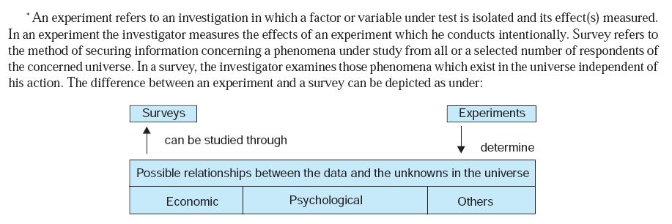

Slide 62
COLLECTION OF PRIMARY DATA
Important ones are:
(i) observation method,
(ii) interview method,
(iii) questionnaires,
(iv) schedules,
(v) other methods which include:
(a) warranty cards;
(b) distributor audits;
(c) pantry audits;
(d) consumer panels;
(e) using mechanical devices;
(f) through projective techniques;
(g) depth interviews, and (h) content analysis

Slide 63
Observation Method
The observation method is the most commonly used method specially in studies relating to behavioral sciences.
Observation becomes a scientific tool and the method of data collection for the researcher, when it serves a formulated research purpose, is systematically planned and recorded and is subjected to checks and controls on validity and reliability.
The main advantage of this method is that subjective bias is eliminated, if observation is done accurately.
structured observation.
unstructured observation.
participant observation.
non-participant observation. (disguised observation.)

Slide 64
Interview Method
The interview method of collecting data involves presentation of oral-verbal stimuli and reply in terms of oral-verbal responses.
This method can be used through personal interviews and, if possible, through telephone interviews.

Slide 65
COLLECTION OF DATA THROUGH QUESTIONNAIRES
This method of data collection is quite popular, particularly in case of big enquiries. It is being adopted by private individuals, research workers, private and public organisations and even by governments. In this method a questionnaire is sent (usually by post) to the persons concerned with a request to answer the questions and return the questionnaire.
The merits claimed on behalf of this method are as follows:
1. There is low cost even when the universe is large and is widely spread geographically.
2. It is free from the bias of the interviewer; answers are in respondents’ own words.
3. Respondents have adequate time to give well thought out answers.
4. Respondents, who are not easily approachable, can also be reached conveniently.
5 Large samples can be made use of and thus the results can be made more dependable and reliable.

Slide 66
COLLECTION OF DATA THROUGH QUESTIONNAIRES
The main demerits of this system can also be listed here:
1. Low rate of return of the duly filled in questionnaires; bias due to no-response is often indeterminate.
2. It can be used only when respondents are educated and cooperating.
3. The control over questionnaire may be lost once it is sent.
4. There is inbuilt inflexibility because of the difficulty of amending the approach once questionnaires have been despatched.
5. It is difficult to know whether willing respondents are truly representative.
6. This method is likely to be the slowest of all.

Slide 67
COLLECTION OF DATA THROUGH SCHEDULES
This method of data collection is very much like the collection of data through questionnaire, with little difference which lies in the fact that are being filled in by the enumerators who are specially appointed for the purpose.
These enumerators along with schedules, go to respondents, put to them the questions from the proforma in the order the questions are listed and record the replies in the space meant for the same in the proforma.
In certain situations, schedules may be handed over to respondents and enumerators may help them in recording their answers to various questions in the said schedules.
Enumerators explain the aims and objects of the investigation and also remove the difficulties which any respondent may feel in understanding the implications of a particular question or the definition or concept of difficult terms. This method requires the selection of enumerators for filling up schedules or assisting respondents to fill up schedules and as such enumerators should be very carefully selected.
The enumerators should be trained to perform their job well and the nature and scope of the investigation should be explained to them thoroughly so that they may well understand the implications of different questions put in the schedule.
Enumerators should be intelligent and must possess the capacity of cross examination in order to find out the truth. Above all, they should be honest, sincere, hardworking and should have patience and perseverance.
This method of data collection is very useful in extensive enquiries and can lead to fairly reliable results.
It is, however, very expensive and is usually adopted in investigations conducted by governmental agencies or by some big organisations.

Slide 68
SOME OTHER METHODS OF DATA COLLECTION
1. Warranty cards: Warranty cards are usually postal sized cards which are used by dealers of
consumer durables to collect information regarding their products. The information sought is printed
in the form of questions on the ‘warranty cards’ which is placed inside the package along with the
product with a request to the consumer to fill in the card and post it back to the dealer.
2. Distributor or store audits: Distributor or store audits are performed by distributors as well as
manufactures through their salesmen at regular intervals. Distributors get the retail stores audited
through salesmen and use such information to estimate market size, market share, seasonal purchasing
pattern and so on. The data are obtained in such audits not by questioning but by observation.
3. Pantry audits: Pantry audit technique is used to estimate consumption of the basket of goods at
the consumer level. In this type of audit, the investigator collects an inventory of types, quantities and
prices of commodities consumed. Thus in pantry audit data are recorded from the examination of
consumer’s pantry. The usual objective in a pantry audit is to find out what types of consumers buy
certain products and certain brands, the assumption being that the contents of the pantry accurately
portray consumer’s preferences.

Slide 69
4. Consumer panels:
A consumer panel is essentially a sample of consumers who are interviewed repeatedly over a period of time. Mostly consume panels are of two types viz., the transitory consumer panel
and the continuing consumer panel.
A transitory consumer panel is set up to measure the effect of a particular phenomenon.
A continuing consumer panel is often set up for an indefinite period with a view to collect data on a particular aspect of consumer behaviour over time, generally at periodic intervals or may be meant to serve as a general purpose panel for researchers on a variety of subjects.
5. Use of mechanical devices:
The use of mechanical devices has been widely made to collect information by way of indirect means. Eye camera, Pupilometric camera, Psychogalvanometer, Motion picture camera and Audiometer are the principal devices so far developed and commonly used by modern big business houses, mostly in the developed world for the purpose of collecting the required information. Eye cameras are designed to record the focus of eyes of a respondent on a specific portion of a sketch or diagram or written material. Such an information is useful in designing advertising material.

Slide 70
6. Projective techniques:
Projective techniques for the collection of data have been developed by psychologists to use projections of respondents for inferring about underlying motives, urges, or intentions which are such that the respondent either resists to reveal them or is unable to figure out himself.
(i) Word association tests
(ii) Sentence completion tests
(iii) Story completion tests
(iv) Verbal projection tests
(v) Pictorial techniques
(vi) Play techniques
(vii) Quizzes, tests and examinations
(viii) Sociometry

Slide 71
7. Depth interviews: Depth interviews are those interviews that are designed to discover underlying motives and desires and are often used in motivational research. Such interviews are held to explore needs, desires and feelings of respondents.
8. Content-analysis: Content-analysis consists of analysing the contents of documentary materials such as books, magazines, newspapers and the contents of all other verbal materials which can be either spoken or printed.

Slide 72
COLLECTION OF SECONDARY DATA
Secondary data means data that are already available Usually published data are available in:
(a)various publications of the central, state are local government
(b) various publications of foreign governments or of international bodies and their subsidiary organizations
(c) technical and trade journals
(d) books, magazines and newspapers
(e) reports and publications of various associations connected with business and industry, banks, stock exchanges, etc.
(f) reports prepared by research scholars, universities, economists, etc. in different fields;
(g) public records and statistics, historical documents, and other sources of published information.

Slide 73
COLLECTION OF SECONDARY DATA
The researcher, before using secondary data, must see that they possess following characteristics:
1. Reliability of data: The reliability can be tested by finding out such things about the said data:
(a) Who collected the data? (b) What were the sources of data? (c) Were they collected by using
proper methods (d) At what time were they collected?(e) Was there any bias of the compiler?
(t) What level of accuracy was desired? Was it achieved ?
2. Suitability of data: The data that are suitable for one enquiry may not necessarily be found
suitable in another enquiry.
3. Adequacy of data: If the level of accuracy achieved in data is found inadequate for the purpose
of the present enquiry, they will be considered as inadequate and should not be used by the researcher.

Slide 74
SELECTION OF APPROPRIATE METHOD FOR DATA COLLECTION
1. Nature, scope and object of enquiry: This constitutes the most important factor affecting the choice of a particular method. The method selected should be such that it suits the type of enquiry that is to be conducted by the researcher
2. Availability of funds: Availability of funds for the research project determines to a large extent the method to be used for the collection of data.
3. Time factor: Availability of time has also to be taken into account in deciding a particular method of data collection.
4. Precision required: Precision required is yet another important factor to be considered at the time of selecting the method of collection of data.

Slide 75
CASE STUDY METHOD
Meaning:
The case study method is a very popular form of qualitative analysis and involves a careful and complete observation of a social unit, be that unit a person, a family, an institution, a cultural group or even the entire community.

Slide 77
7 Processing and Analysis of Data
Technically speaking, processing implies :
editing,
coding,
classification
(a) Classification according to attributes: qualitative phenomenon ; either be descriptive (such as literacy, sex, honesty, etc.) or numerical (such as weight, height, income, etc.).
(b) Classification according to class-intervals:
quantitative phenomenon; Data relating to income, production, age, weight, etc. come under this category. Such data are known as statistics of variables and are classified on the basis of class intervals.
4. Tabulation of collected data so that they are amenable to analysis. tabulation is the process of summarizing raw data and displaying the same in compact form (i.e., in the form of statistical tables) for further analysis.

Slide 78
ELEMENTS/TYPES OF ANALYSIS
Analysis may, therefore, be
categorized as descriptive analysis and inferential analysis (Inferential analysis is often known as statistical analysis).
“Descriptive analysis is largely the study of distributions of one variable.
This study provides us with profiles of companies, work groups, persons and other subjects on any of a multiple of characteristics such as size. Composition, efficiency, preferences, etc.”. this sort of analysis may be in respect of one variable (described as unidimensional analysis), or in respect of two variables (described as bivariate analysis) or in respect of more than two variables (described as multivariate analysis).
In this context we work out various measures that show the size and shape of a distribution(s) along with the study of measuring relationships between two or more variables.

Slide 79
Correlation analysis studies : the joint variation of two or more variables for determining the amount of correlation between two or more variables.
Causal analysis (This analysis can be termed regression analysis. ) :
is concerned with the study of how one or more variables affect changes in another variable.

Slide 80
multivariate analysis
“all statistical methods which simultaneously analyze more than two variables on a sample of observations”.
(a) Multiple regression analysis: one dependent variable which is presumed to be a function of two or more independent variables. The objective is to make a prediction about the dependent variable based on its covariance with all the concerned independent variables.
(b) Multiple discriminant analysis: single dependent variable that cannot be measured, but can be classified into two or more groups on the basis of some attribute. The object to predict an entity’s possibility of belonging to a particular group based on several predictor variables.
(c) Multivariate analysis of variance (or multi-ANOVA):
This analysis is an extension of two-way ANOVA, wherein the ratio of among group variance to within group variance is worked out on a set of variables.

Slide 81
STATISTICS IN RESEARCH
If fact, there are two major areas of statistics viz., descriptive statistics and inferential statistics. Descriptive statistics concern the development of certain indices from the raw data, whereas inferential statistics concern with the process of generalization.
Inferential statistics are also known as sampling statistics and are mainly concerned with two major type of problems: (i) the estimation of population parameters, (ii) the testing of statistical hypotheses.
The important statistical measures* that are used to summarize the survey/research data are:
measures of central tendency or statistical averages; the arithmetic average or mean, median and mode. Geometric mean and harmonic mean are also sometimes used.
measures of dispersion; variance, and its square root—the standard deviation are the most often used measures. Other measures such as mean deviation, range, etc. are also used. . For comparison purpose, we use mostly the coefficient of standard deviation or the coefficient of variation.
measures of asymmetry (skewness and kurtosis);
measures of relationship; Karl Pearson’s coefficient of correlation is the frequently used measure in case of statistics of variables, whereas Yule’s coefficient of association is used in case of statistics of attributes. Multiple correlation coefficient, partial correlation coefficient, regression analysis, etc
other measures. ., Index numbers, analysis of time series, coefficient of contingency, etc., are other measures that may as well be used by a researcher, depending upon the nature of the problem under study.

Slide 82
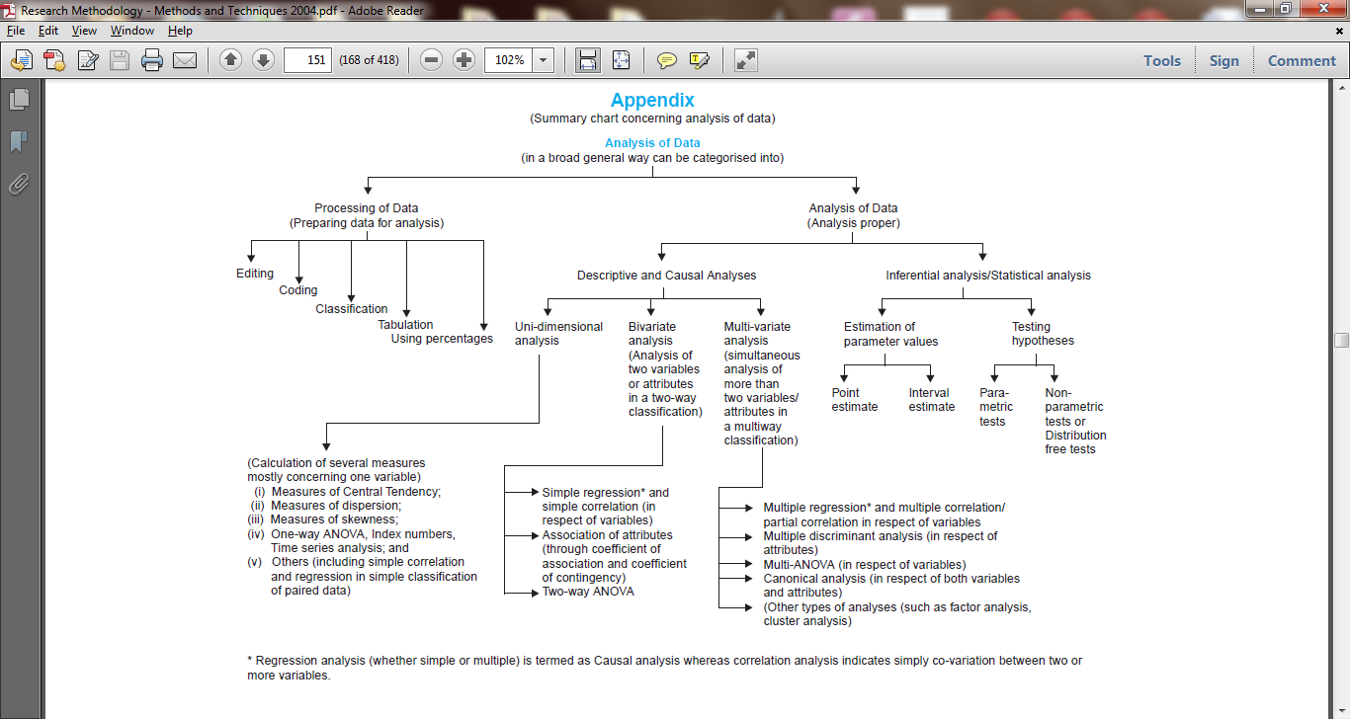

Slide 83
8 Sampling
The items so selected constitute what is technically called a sample, their selection process or technique is called sample design and the survey conducted on the basis of sample is described as sample survey.

Slide 84
SOME FUNDAMENTAL DEFINITIONS
1. Universe/Population: The population or universe can be finite or infinite.
2. Sampling frame: The elementary units or the group or cluster of such units may form the basis of sampling process in which case they are called as sampling units.
3. Sampling design: A sample design is a definite plan for obtaining a sample from the sampling frame.
4. Statisitc(s) and parameter(s): A statistic is a characteristic of a sample, whereas a parameter is a characteristic of a population.

Slide 85
5. Sampling error: Sample surveys do imply the study of a small portion of the population and as such there would naturally be a certain amount of inaccuracy in the information collected.
The meaning of sampling error can be easily understood from the following diagram:

Slide 86
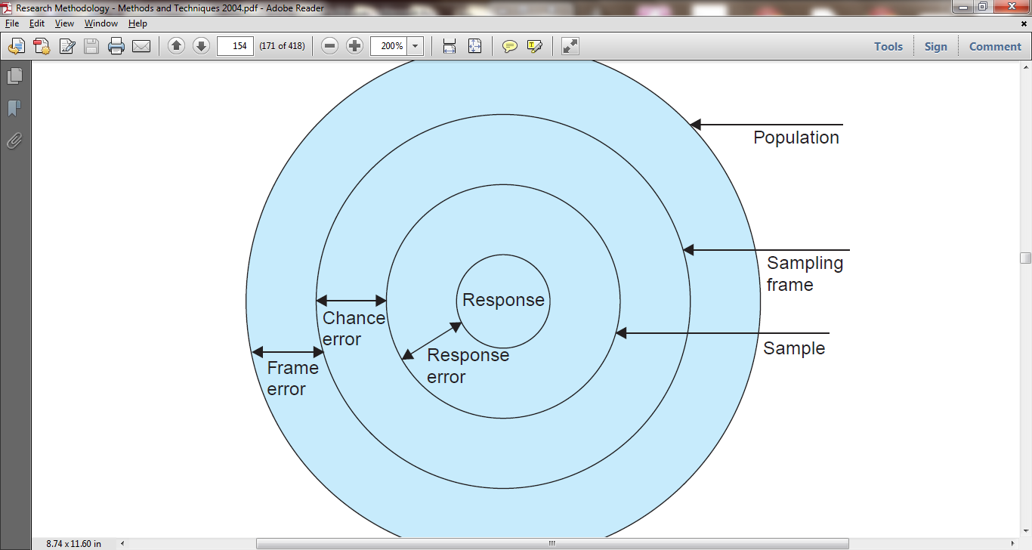
Fig. 8.1 Sampling error = Frame error + Chance error + Response

Slide 87
6. Precision:
Precision is the range within which the population average (or other parameter) will lie in accordance with the reliability specified in the confidence level as a percentage of the estimate ± or as a numerical quantity.
For instance, if the estimate is Rs 4000 and the precision desired is ± 4%, then the true value will be no less than Rs 3840 and no more than Rs 4160.

Slide 88
7. Confidence level and significance level:
The confidence level or reliability is the expected percentage of times that the actual value will fall within the stated precision limits. Thus, if we take a confidence level of 95%, then we mean that there are 95 chances in 100 (or .95 in 1) that the sample results represent the true condition of the population within a specified precision range against5 chances in 100 (or .05 in 1) that it does not.

Slide 89
8. Sampling distribution:
We are often concerned with sampling distribution in sampling analysis.
If we take certain number of samples and for each sample compute various statistical measures such as mean, standard deviation, etc., then we can find that each sample may give its own value for the statistic under consideration.

Slide 90
IMPORTANT SAMPLING DISTRIBUTIONS
Some important sampling distributions, which are commonly used, are:
(1) sampling distribution of mean;
(2) sampling distribution of proportion;
(3) student’s ‘t’ distribution;
(4) F distribution; and
(5) Chi-square distribution.

Slide 91
central limit theorem
from a normal population, the means of samples drawn from such a population are themselves normally distributed.
But when sampling is not from a normal population, the size of the sample plays a critical role. When n is small, the shape of the distribution will depend largely on the shape of the parent population, but as n gets large (n > 30), the thape of the sampling distribution will become more and more like a normal distribution, irrespective of the shape of the parent population.

Slide 92
“The significance of the central limit theorem lies in the fact that it permits us to use sample statistics to make inferences about population parameters without knowing anything about the shape of the frequency distribution of that population other than what we can get from the sample.”

Slide 93
SAMPLING THEORY
Sampling theory is a study of relationships existing between a population and samples drawn from the population.
Sampling theory is designed to attain one or more of the following objectives:
(i) Statistical estimation:
The estimate can either be a point estimate or it may be an interval estimate.

Slide 94
(ii) Testing of hypotheses:
The second objective of sampling theory is to enable us to decide whether to accept or reject hypothesis;
(iii) Statistical inference:
Sampling theory helps in making generalization about the population/ universe from the studies based on samples drawn from it. It also helps in determining the accuracy of such generalizations.

Slide 95
CONCEPT OF STANDARD ERROR The standard deviation
The standard deviation of sampling distribution of a statistic is known as its standard error (S.E) and is considered the key to sampling theory.
The utility of the concept of standard error in statistical induction arises on account of the following reasons:
1. The (S.E) helps in testing whether the difference between observed and expected frequencies could arise due to chance. The criterion usually adopted is that if a difference is less than 3 times the S.E., the difference is supposed to exist as a matter of chance and if the difference is equal to or more than 3 times the S.E., chance fails to account for it, and we conclude the difference as significant difference. This criterion is based on the fact that at X ± 3 (S.E.) the normal curve covers an area of 99.73 per cent.

Slide 96
2. The standard error gives an idea about the reliability and precision of a sample. The smaller the S.E., the greater the uniformity of sampling distribution and hence, greater is the reliability of sample.
Conversely, the greater the S.E., the greater the difference between observed and expected frequencies. In such a situation the unreliability of the sample is greater.

Slide 97
3. The standard error enables us to specify the limits within which the parameters of the population are expected to lie with a specified degree of confidence. Such an interval is usually known as confidence interval.

Slide 98
ESTIMATION
In most statistical research studies, population parameters are usually unknown and have to be estimated from a sample.

Slide 99
sample size and its detemination
In sampling analysis the most ticklish question what should be the size of the sample or how large or small should be ‘n’? If the sample size (‘n’) is too small, it may not serve to achieve the objectives and if it is too large, we may incur huge cost and waste resources.

Slide 100
DETERMINATION OF SAMPLE SIZE THROUGH THE APPROACH BASED ON PRECISION RATE & CONFIDENCE LEVEL
To begin with, it can be stated that whenever a sample study is made, there arises some sampling error which can be controlled by selecting a sample of adequate size.

Slide 101
9 Testing of Hypotheses I (Parametric or Standard Tests of Hypotheses)
Hypothesis is usually considered as the principal instrument in and research.
Ordinarily, when one talks about hypothesis, one simply means a mere assumption or some supposition to be proved or disproved. But for a researcher hypothesis is a formal question that he intends

Slide 102
“Students who receive counseling will show a greater increase in creativity than students not receiving counselling”
Or “the automobile A is performing as well as automobile B.”
These are hypotheses capable of being objectively verified and tested.

Slide 103
Characteristics of hypothesis:
Hypothesis must possess the following characteristics:
Hypothesis should be clear and precise.
(ii) Hypothesis should be capable of being tested.
(iii) Hypothesis should state relationship between variables, if it happens to be a relational hypothesis.
(iv) Hypothesis should be limited in scope and must be specific.
(v) Hypothesis should be stated as far as possible in most simple terms
(vi) Hypothesis should be consistent with most known facts
(vii) Hypothesis should be amenable to testing within a reasonable time.
(viii) Hypothesis must explain the facts that gave rise to the need for explanation.

Slide 104
BASIC CONCEPTS CONCERNING TESTING OF HYPOTHESES
(a) Null hypothesis and alternative hypothesis

Slide 105
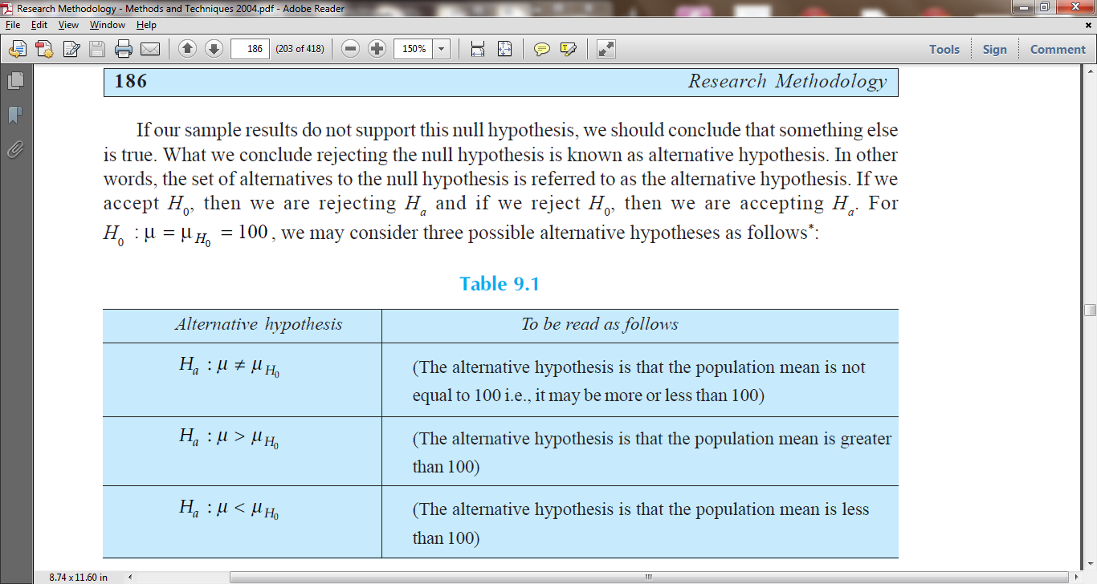
possible alternative hypothesis

Slide 106
b) The level of significance:
This is a very important concept in the context of hypothesis testing . It is always some percentage (usually 5%) which should be chosen wit great care, thought and reason.

Slide 107
(c) Decision rule or test of hypothesis: Given a hypothesis H0 and an alternative hypothesis Ha,
we make a rule which is known as decision rule according to which we accept H0 (i.e., reject Ha) or reject H0 (i.e., accept Ha).

Slide 108
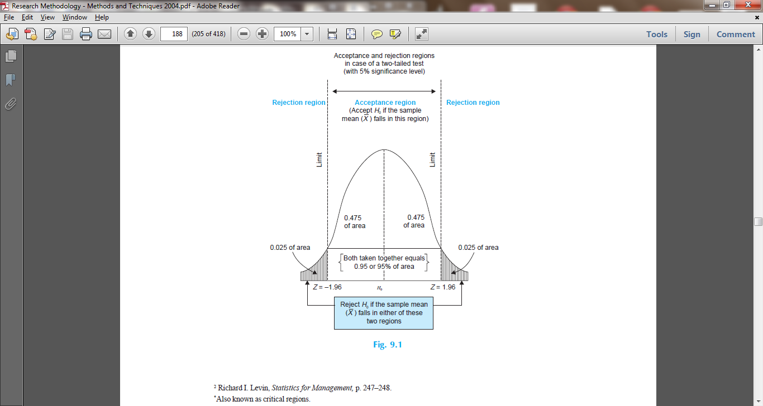
Acceptance and rejection regions in case of a two-tailed test (with 5% significance level)

Slide 109
PROCEDURE FOR HYPOTHESIS TESTING
the main question is:
whether to accept the null hypothesis or not to accept the null hypothesis? Procedure for hypothesis testing refers to all those steps that we undertake for making a choice between the two actions i.e., rejection and acceptance of a null hypothesis. The various steps involved in hypothesis testing are stated below:
(i) Making a formal statement: The step consists : null hypothesis is H0 : m = 10 tons
Alternative Hypothesis Ha: m > 10 tons
(ii) Selecting a significance level:
(iii) Deciding the distribution to use: (iv) Selecting a random sample and computing an appropriate value
(vi) Comparing the probability: Yet another step consists in comparing the probability thus calculated with the specified value for a , the significance level.

Slide 110
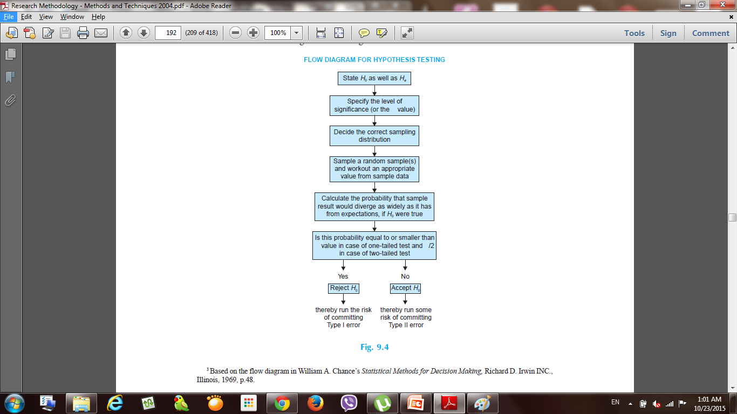
FLOW DIAGRAM FOR HYPOTHESIS TESTING

Slide 111
TESTS OF HYPOTHESES
classified as:
(a) Parametric tests or standard tests of hypotheses; (1) z-test; (2) t-test; x2-test, and (4) F-test. All these tests are based on the assumption of normality i.e., the source of data is considered to be normally distributed.
(b) Non-parametric tests or distribution-free test of hypotheses.

Slide 112
10 Chi-Square Test
Chi-square, symbolically written as c2 (Pronounced as Ki-square), is a statistical measure used in the context of sampling analysis for comparing a variance to a theoretical variance.
As a non-parametric test, it “can be used to determine if categorical data shows dependency or the two classifications are independent. It can also be used to make comparisons between theoretical populations and actual data when categories are used.”

Slide 113
The test is, in fact, a technique through the use of which it is possible for all researchers to
(i) test the goodness of fit;
(ii) test the significance of association between two attributes, and
(iii) test the homogeneity or the significance of population variance.

Slide 114
chi-square can be used
(i) as a test of goodness of fit and
(ii) as a test of independence.

Slide 115
No group should contain very few items, say less than 10. I
n case where the frequencies are less than 10, regrouping is done by combining the frequencies of adjoining groups so that the new frequencies become greater than 10.
Some statisticians take this number as 5, but 10 is regarded as better by most of the statisticians.

Slide 116
11 Analysis of Variance and Co-variance
ANALYSIS OF VARIANCE (ANOVA) ANOVA is essentially a procedure for testing the difference among different groups of data for homogeneity.

Slide 117
12 Testing of Hypotheses-II (Nonparametric or Distribution-free Tests)
are important and generally used:
(i) one-sample sign test.
(ii) two-sample sign test, Fisher-Irwin test, Rank sum test, etc.
(iii) Rank correlation, Kendall’s coefficient of concordance and other tests for dependence.
(iv) test analogous to ANOVA viz., Kruskal-Wallis test.
(v) Tests of randomness of a sample based on the theory of runs viz., one sample runs test.

Slide 118
13 Multivariate Analysis Techniques All statistical
Of late, multivariate techniques have emerged as a powerful tool to analyze data represented in terms of many variables.
The main reason being that a series of univariate analysis carried out separately for each variable may, at times, lead to incorrect interpretation of the result.

Slide 119
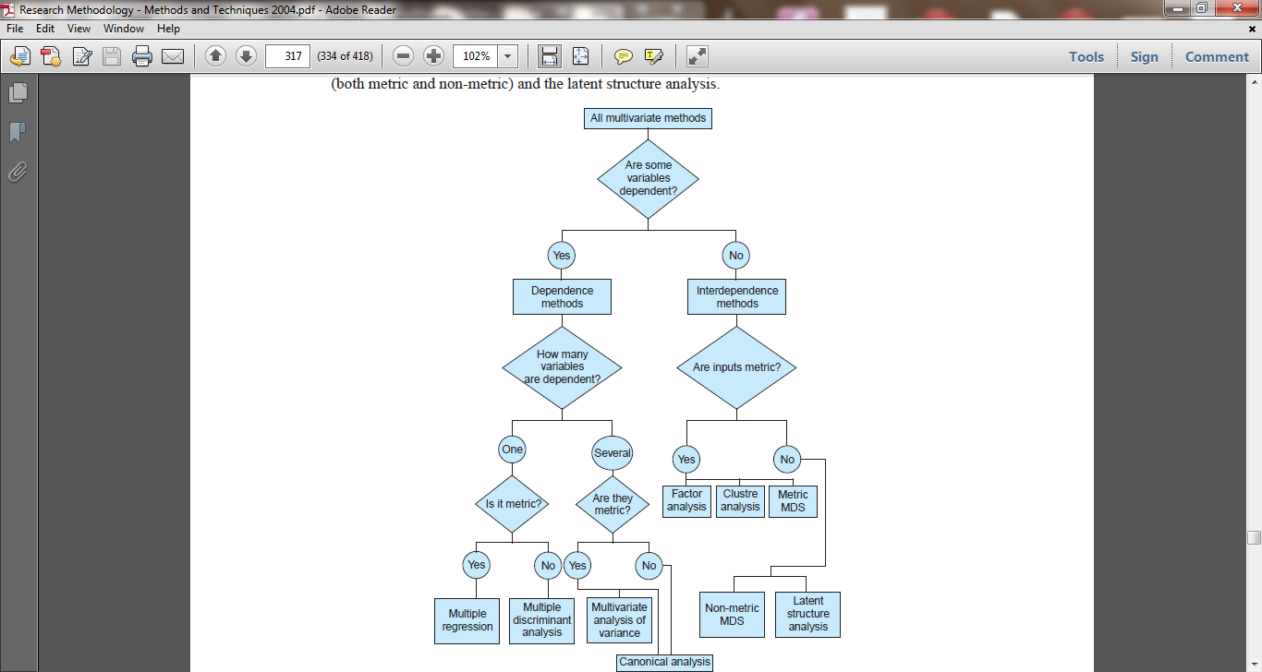
Thus, we have two types of multivariate techniques: one type for data containing both dependent and independent variables, and the other type for data containing several variables without dependency relationship.

Slide 120
14 Interpretation and Report Writing After collecting and analyzing
DIFFERENT STEPS IN WRITING REPORT
Research reports are the product of slow, painstaking, accurate inductive work. The usual steps involved in writing report are:
(a) logical analysis of the subject-matter;
(b) preparation of the final outline;
(c) preparation of the rough draft;
(d) rewriting and polishing;
(e) preparation of the final bibliography;
(f) writing the final draft.
Though all these steps are self explanatory, yet a brief mention of each one of these will be appropriate for better understanding.

Slide 121
TYPES OF REPORTS ,Research reports
(A) Technical Report
In the technical report the main emphasis is on (i) the methods employed, (it) assumptions made in the course of the study, (iii) the detailed presentation of the findings including their limitations and supporting data.
A general outline of a technical report can be as follows:
1. Summary of results: A brief review of the main findings just in two or three pages.
2. Nature of the study: Description of the general objectives of study, formulation of the problem in
operational terms, the working hypothesis, the type of analysis and data required, etc.
3. Methods employed: Specific methods used
4. Data: Discussion of data collected, their sources, characteristics and limitations. If secondary
5. Analysis of data and presentation of findings: The analysis of data and presentation of the
findings of the study with supporting data in the form of tables and charts be fully narrated. This, in
fact, happens to be the main body of the report usually extending over several chapters.
6. Conclusions: A detailed summary of the findings and the policy implications drawn from the
results be explained.
7. Bibliography: Bibliography of various sources consulted be prepared and attached.
8. Technical appendices: Appendices be given for all technical matters relating to questionnaire,
mathematical derivations, elaboration on particular technique of analysis and the like ones.
9. Index:

Slide 122
(B) Popular Report
The popular report is one which gives emphasis on simplicity and attractiveness. We give below a general outline of a popular report.
1. The findings and their implications: Emphasis in the report is given on the findings of most practical interest and on the implications of these findings.
2. Recommendations for action: Recommendations for action on the basis of the findings of the study is made in this section of the report.
3. Objective of the study: A general review of how the problem arise is presented along with the specific objectives of the project under study.
4. Methods employed: A brief and non-technical description of the methods and techniques used, including a short review of the data on which the study is based, is given in this part of the report.
5. Results: This section constitutes the main body of the report wherein the results of the study are presented in clear and non-technical terms with liberal use of all sorts of illustrations such as charts, diagrams and the like ones.
6. Technical appendices: More detailed information on methods used, forms, etc. is presented in the form of appendices. But the appendices are often not detailed if the report is entirely meant for general public.

Slide 123
15 The Computer: Its Role in Research
The Computer is of the most versatile and ingenious developments of the modern technological age. Today people use computers in almost every walk of life.

Slide 124
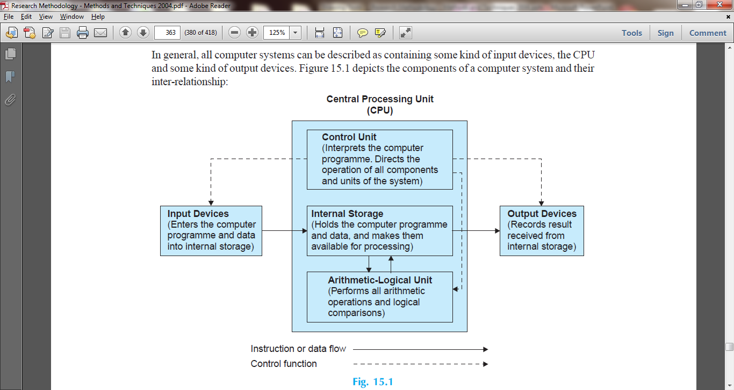

Slide 125
Selected References and Recommended Readings
1. Ackoff, Russell L., The Design of Social Research, Chicago: University of Chicago Press, 1961.
2. Ackoff, Russell L., Scientific Method, New York: John Wiley & Sons, 1962.
3. Allen, T. Harrell, New Methods in Social Science Research, New York: Praeger Publishers, 1978.
4. Anderson, H.H., and Anderson, G.L., An Introduction to Projective Techniques and Other Devices for
Understanding the Dynamics of Human Behaviour, New York: Prentice Hall, 1951.
5. Anderson, T.W., An Introduction to Multivariate Analysis, New York: John Wiley & Sons, 1958.
6. Bailey, Kenneth D., “Methods of Social Research,” New York, 1978.
7. Baker, R.P., and Howell, A.C., The Preparation of Reports, New York: Ronald Press, 1938.
8. Bartee, T.C., “Digital Computer Fundamentals,” 5th Ed., McGraw-Hill, International Book Co., 1981.
9. Barzun, Jacques, and Graff, Henery, F., The Modern Researcher, rev. ed., New York: Harcourt, Brace &
World, Inc., 1970.
10. Bell, J.E., Projective Techniques: A. Dynamic Approach to the Study of Personality, New York: Longmans
Green, 1948.
11. Bellenger, Danny N., and Greenberg, Barnett A., Marketing Research—A Management Information
Approach, Homewood, Illinois: Richard D. Irwin, Inc., 1978.
12. Berdie, Douglas R., and Anderson, John F., Questionnaires: Design and Use, Metuchen N.J.: The
Scarecrow Press, Inc., 1974.
13. Berelson, Bernard, Content Analysis in Communication Research, New York: Free Press, 1952.
14. Berenson, Conard, and Colton, Raymond, Research and Report Writing for Business and Economics,
New York: Random House, 1971.
15. Best, John W., and Kahn, James V., “Research in Education,” 5th Ed., New Delhi: Prentice-Hall of India
Pvt. Ltd., 1986.
16. Bhattacharya, Srinibas, Psychometrics & Behavioural Research, New Delhi: Sterling Publishers Pvt.
Ltd., 1972.
17. Boot, John C.G., and Cox, Edwin B., Statistical Analysis for Managerial Decisions, 2nd ed. New Delhi:
McGraw-Hill Publishing Co. Ltd., (International Student Edition), 1979.
18. Bowley, A.L., Elements of Statistics, 6th ed. London: P.S. King and Staples Ltd., 1937.

Slide 126
19. Burgess, Ernest W., “Research Methods in Sociology” in Georges Gurvitch and W.E. Moore (Ed.),
Twentieth Century Sociology, New York: New York Philosophical Library, 1949.
20. Chance, William A., Statistical Methods for Decision Making, Bombay: D.B. Taraporevala Sons & Co.
Pvt. Ltd., 1975.
21. Chaturvedi, J.C., Mathematical Statistics, Agra: Nok Jhonk Karyalaya, 1953.
22. Chou, Ya-Lun, Statistical Analysis with Business and Economic Applications, 2nd ed. New York: Holt,
Rinehart & Winston, 1974.
23. Clover, Vernon T., and Balsley, Howard L., Business Research Methods, Columbus, O.: Grid, Inc., 1974.
24. Cochran, W.G., Sampling Techniques, 2nd ed. New York: John Wiley & Sons., 1963.
25. Cooley, William W., and Lohnes, Paul R., Multivariate Data Analysis, New York: John Wiley & Sons.,
1971.
26. Croxton, F.E., Cowden, D.J., and Klein, S., Applied General Statistics, 3rd ed., New Delhi: Prentice-Hall of
India Pvt. Ltd., 1975.
27. Dass, S.L., Personality Assessment Through Projective Movie Pictures, New Delhi: S. Chand & Co.
(Pvt.) Ltd., 1974.
28. Davis, G.B., “Introduction to Computers,” 3rd ed., McGraw-Hill International Book Co., 1981.
29. Deming, W. Edwards., Sample Design in Business Research, New York: John Wiley & Sons., Inc., 1960.
30. Dennis, Child, The Essentials of Factor Analysis, New York: Holt, Rinehart and Winston, 1973.
31. Denzin, Norman, The Research Act, Chicago: Aldine, 1973.
32. Edwards, Allen, Statistical Methods, 2nd ed., New York: Holt, Rinehart & Winston, 1967.
33. Edwards, Allen L., Techniques of Attitude Scale Construction, New York: Appleton-Century-Crofts,
1957.
34. Emory, C. William, Business Research Methods, Illinois: Richard D. Irwin, Inc. Homewood, 1976.
35. Ferber, Robert (ed.), Handbook of Marketing Research, New York: McGraw-Hill, Inc., 1948.
36. Ferber, R., and Verdoorn, P.J., Research Methods in Economics and Business, New York: The Macmillan
Company, 1962.
37. Ferguson, George A., Statistical Analysis in Psychology and Education, 4th ed., New York: McGraw-
Hill Book Co., Inc., 1959.
38. Festinger, Leon and Katz, Daniel (Eds.), Research Methods in the Behavioral Sciences, New Delhi:
Amerind Publishing Co. Pvt. Ltd., Fourth Indian Reprint, 1976.
39. Fiebleman, J.K., Scientific Method, Netherlands: Martinus Nijhoff, The Hague, 1972.
40. Fisher, R.A., Statistical Methods for Research Workers, 13th ed., New York: Hafner Publishing Co., 1958.
41. Fisher, R.A., The Design of Experiments, 7th rev. ed., New York: Hafner Publishing Co., 1960.
42. Fox, James Harold, Criteria of Good Research, Phi Delta Kappa, Vol. 39 (March 1958).
43. Freedman, P., The Principles of Scientific Research, 2nd ed., New York: Pergamon Press, 1960.
44. Fruchter, Benjamin, Introduction to Factor Analysis, Princeton, N.J.: D.Van Nostrand, 1954.
45. Gatner, Elliot S.M., and Cordasco, Francesco, Research and Report Writing, New York: Barnes & Noble,
Inc., 1956.
46. Gaum, Carl G., Graves, Harod F., and Hoffman, Lyne, S.S., Report Writing, 3rd ed., New York: Prentice-Hall,
1950.
47. Ghosh, B.N., Scientific Methods and Social Research, New Delhi: Sterling Publishers Pvt. Ltd., 1982.
48. Gibbons, J.D., Nonparametric Statistical Inference, Tokyo: McGraw-Hill Kogakusha Ltd., (International
Student Edition), 1971.

Slide 127
49. Giles, G.B., Marketing, 2nd ed., London: Macdonald & Evans Ltd., 1974.
50. Glock, Charles Y., Survey Research in the Social Sciences, New York: Russell Sage Foundation, 1967.
51. Godfrey, Arthur, Quantitative Methods for Managers, London: Edward Arnold (Publishers) Ltd., 1977.
52. Good, Carter V., and Douglas, E. Scates, Methods of Research—Educational, Psychological, Sociological,
New York: Appleton-Century-Crofts, Inc., 1954.
53. Goode, William J., and Hatt, Paul K., Methods in Social Research, New York: McGraw-Hill, 1952.
54. Gopal, M.H., An Introduction to Research Procedure in Social Sciences, Bombay: Asia Publishing
House, 1964.
55. Gopal, M.H., Research Reporting in Social Sciences, Dharwar: Karnatak University, 1965.
56. Gorden, Raymond L., Interviewing: Strategy, Techniques and Tactics, rev. ed., Homewood, Ill.: Dorsey
Press, 1975.
57. Green, Paul E., Analyzing Multivariate Data, Hinsdale, Ill.: Dryden Press, 1978.
58. Green, Paul E., and Carmone, F.J., Multidimensional Scaling in Marketing Analysis, Boston: Allyn &
Bacon, Inc., 1970.
59. Guilford, J.P., Psychometric Methods, New York: McGraw Hill, Inc., 1954.
60. Harnett, Donald L., and Murphy, James L., Introductory Statistical Analysis, Philippines: Addison-
Wesley Publishing Co., Inc., 1975.
61. Hillway, T., Introduction to Research, 2nd ed., Boston: Houghton Mifflin, 1964.
62. Hollander, Myles, and Wolfe, Douglas A., Nonparametric Statistical Methods, New York: John Wiley,
1973.
63. Hunt, R., and Shelley, J., “Computers and Common Sense,” 3rd ed., New Delhi: Prentice-Hall of India Ltd.,
1984.
64. Hyman, Herbert H., et al., Interviewing in Social Research, Chicago: University of Chicago Press, 1975.
65. John, Peter W.M., Statistical Design and Analysis of Experiments, New York: The Macmillan Co., 1971.
66. Johnson, Ellen, The Research Report: A Guide for the Beginner, New York: Ronald Press, 1951.
67. Johnson, Rodney D., and Siskin, Bernard R., Quantitative Techniques for Business Decisions, New
Delhi: Prentice-Hall of India Pvt. Ltd., 1977.
68. Kahn, Robert L. and Cannell, Charles F., The Dynamics of Interviewing, New York: John Wiley & Sons,
1957.
69. Karson, Marvin J., Multivariate Statistical Methods, Ames, Iowa: The Iowa State University Press, 1982.
70. Kendall, M.G., A Course in Multivariate Analysis, London, Griffin, 1961.
71. Kerlinger, Fred N. and Pedhazur, Elazar J., Multiple Regression in Behavioral Research, New York: Holt,
Rinehart and Winston, 1973.
72. Kerlinger, Fred N., Foundations of Behavioral Research, 2nd ed., New York: Holt, Reinhart and Winston,
1973.
73. Kish, Leslie., Survey Sampling, New York: John Wiley & Sons, Inc., 1965.
74. Kothari, C.R., Quantitative Techniques, 2nd ed., New Delhi: Vikas Publishing House Pvt. Ltd., 1984.
Kothari, C.R., Methods and Techniques, 2nd ed., New Age International (P) Ltd, 2004 .
75. Lastrucci, Carles L., The Scientific Approach: Basic Principles of the Scientific Method, Cambridge,
Mass.: Schenkman Publishing Co., Inc., 1967.
76. Lazersfeld, Paul F., “Evidence and Inference in Social Research,” in David Lerher, Evidence and Inference,
Glencoe: The Free Press, 1950.
77. Leonard Schatzman, and Anselm L. Strauss, Field Research, New Jersey: Prentice-Hall Inc., 1973.
78. Levin, Richard I., Statistics for Management, New Delhi: Prentice-Hall of India Pvt. Ltd., 1979.

Slide 128
79. Levine, S. and Elzey, Freeman F., A Programmed Introduction to Research, California: Wods Worth
Publishing Co., 1968.
80. Maranell, Gary M. (ed.), Scaling: A Source Book for Behavioral Scientists, Chicago: Aldine, 1974.
81. Maxwell, Albert E., Analyzing Qualitative Data, New York: John Wiley & Sons, 1961.
82. Meadows, R., and Parsons, A.J., “Microprocessors: Essentials, Components and Systems,” Pitman, 1983.
83. Meir, Robert C., Newell, William T., and Dazier, Harold L., Simulation in Business and Economics,
Englewood Cliffs, N.J: Prentice Hall, Inc., 1969.
84. Miller, Delbert C., Handbook of Research Design & Social Measurement, 3rd ed., New York: David
Mckay Company, Inc., 1977.
85. Moroney, M.J., Facts from Figures, Baltimore: Penguin Books, 1956.
86. Morrison, Donald F., Multivariate Statistical Methods, New York: McGraw-Hill, 1967.
87. Nagel, Stuart S., and Neef, Marian, Policy Analysis in Social Science Research, London: Sage Publications,
1979.
88. Nie, N.H., Bent, D.H., and Hull, C.H., Statistical Package for the Social Sciences, New York: McGraw-
Hill, 1970.
89. Noether, G.E., Elements of Nonparametric Statistics, New York: John Wiley & Sons, Inc., 1967.
90. Nunnally, Jum C., Psychometric Theory, 2nd ed., New York: McGraw-Hill, 1978.
91. Odum, H.W., and Jocher, Katharine, An Introduction to Social Research, New York: Henry Holt and Co.,
1929.
92. Oppenheim, A.N., Questionnaire Design and Attitude Measurement, New York: Basic Books, 1966.
93. Ostle, Bernard, and Mensing, Richard W., Statistics in Research, 3rd ed., Ames Iowa: The Iowa State
University Press, 1975.
94. Payne, Stanley, The Art of Asking Questions, Princeton: Princeton University Press, 1951.
95. Pearson, Karl, The Grammar of Science, New York: Meridian Books, Inc., 1957.
96. Phillips, Bernard S., Social Research, Strategy and Tactics, 2nd ed., New York: The Macmillan Company,
1971.
97. Piaget, Jean, Main Trends in Interdisciplinary Research, London: George Allen and Unwin Ltd., 1973.
98. Popper, Karl R., The Logic of Scientific Discovery, New York: Basic Books, 1959.
99. Rajaraman, V., “Fundamentals of Computers,” New Delhi: Prentice-Hall of India Pvt. Ltd., 1985.
100. Ramchandran, P., Training in Research Methodology in Social Sciences in India, New Delhi: ICSSR
1971.
101. Redman, L.V., and Mory, A.V.H., The Romance of Research, 1923.
102. Roscoe, John T., Fundamental Research Statistics for the Behavioral Sciences, New York: Holt, Rinehart
and Winston, Inc., 1969.
103. Runyon, Richard P., Inferential Statistics, Philippines: Addison-Wesley Publishing Company, Inc., 1977.
104. Sadhu, A.N., and Singh, Amarjit, Research Methodology in Social Sciences, Bombay: Himalaya Publishing
House, 1980.
105. Seboyar, G.E., Manual for Report and Thesis Writing, New York: F.S. Crofts & Co., 1929.
106. Selltiz, Claire: Jahoda, Marie, Deutsch, Morton, and Cook, Stuart W., Research Methods in Social
Relations, rev. ed. New York: Holt, Rinehart and Winston, Inc., 1959.
107. Sharma, B.A.V., et al., Research Methods in Social Sciences, New Delhi: Sterling Publishers Pvt. Ltd.,
1983.
108. Sharma, H.D., and Mukherji, S.P., Research in Economics and Commerce, Methodology and Surveys,
Varanasi: Indian Biographic Centre, 1976.

Slide 129
109. Siegel, S., Nonparametric Statistics for the Behavioral Sciences, New York: McGraw-Hill Publishing Co.,
Inc., 1956.
110. Subramanian, N., “Introduction to Computers,” New Delhi: Tata McGraw-Hill Publishing Co. Ltd., 1986.
111. Summers, Gene F., (Ed.), Attitude Measurement, Chicago: Rand McNally & Co., 1970.
112. Takeuchi, K., Yanai, H. and Mukherjee, B.N., The Foundations of Multivariate Analysis, New Delhi:
Wiley Eastern Ltd., 1982.
113. Tandon, B.C., Research Methodology in Social Sciences, Allahabad: Chaitanya Publishing House, 1979.
114. Thorndike, Robert L. and Hagen, Elizabeth P., Measurement and Evaluation in Psychology and Education,
4th ed., New York: John Wiley & Sons, 1977.
115. Thurstone, L.L., The Measurement of Values, Chicago: University of Chicago Press, 1959.
116. Torgerson, W., Theory and Methods of Scaling, New York: John Wiley & Sons, 1958.
117. Travers, Robert M.W., An Introduction to Educational Research, 4th ed., New York: Macmillan Publishing
Co., Inc., 1978.
118. Tryon, R.C., and Bailey, D.E., Cluster Analysis, New York: McGraw-Hill, 1970.
119. Ullman, Neil R., Elementary Statistics, New York: John Wiley & Sons, Inc., 1978.
120. Whitney, F.L., The Elements of Research, 3rd ed., New York: Prentice-Hall, 1950.
121. Wilkinson, T.S. and Bhandarkar, P.L., Methodology and Techniques of Social Research, Bombay: Himalaya
Publishing House, 1979.
122. Willemsen, Eleanor Walker, Understanding Statistical Reasoning, San Francisco: W.H. Freeman and
Company, 1974.
123. Yamane, T., Statistics: An Introductory Analysis, 3rd ed., New York: Harper and Row, 1973.
124. Young, Pauline V., Scientific Social Surveys and Research, 3rd ed., New York: Prentice-Hall, 1960

